Slide 1
IBM Data Science Professional Certificate
Battle of Neighborhood
By-ANCHALA BALARAJ

Slide 2
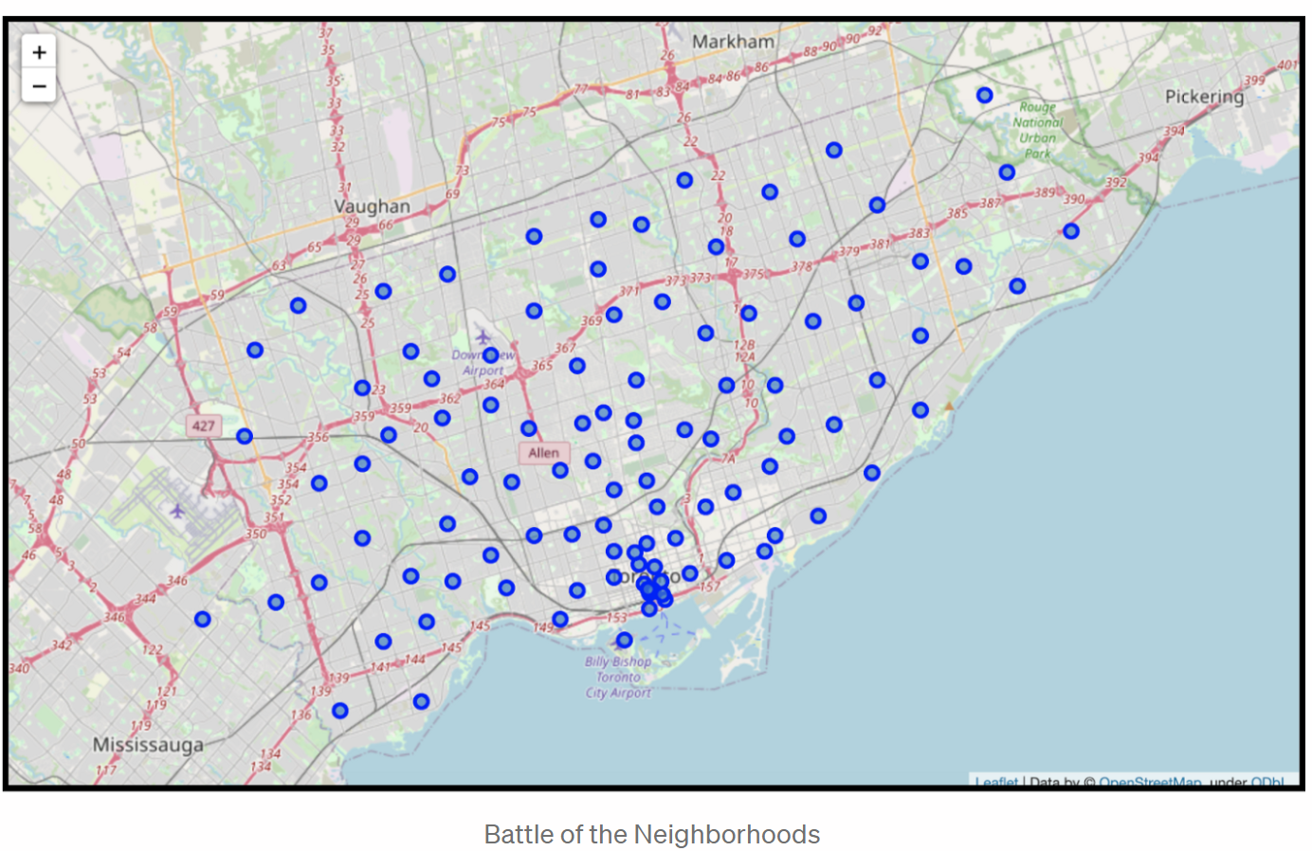
INTRODUCTION
The purpose of this project is to help people in exploring better facilities around their neighborhood. It will help people making smart and efficient decisions on selecting great neighborhoods out of numbers of other neighborhoods in Scarborough, Toronto.
We will be using data visualization techniques, Foursquare API to retrieve location data for the state of Toronto and use this to perform data analysis.

Slide 3
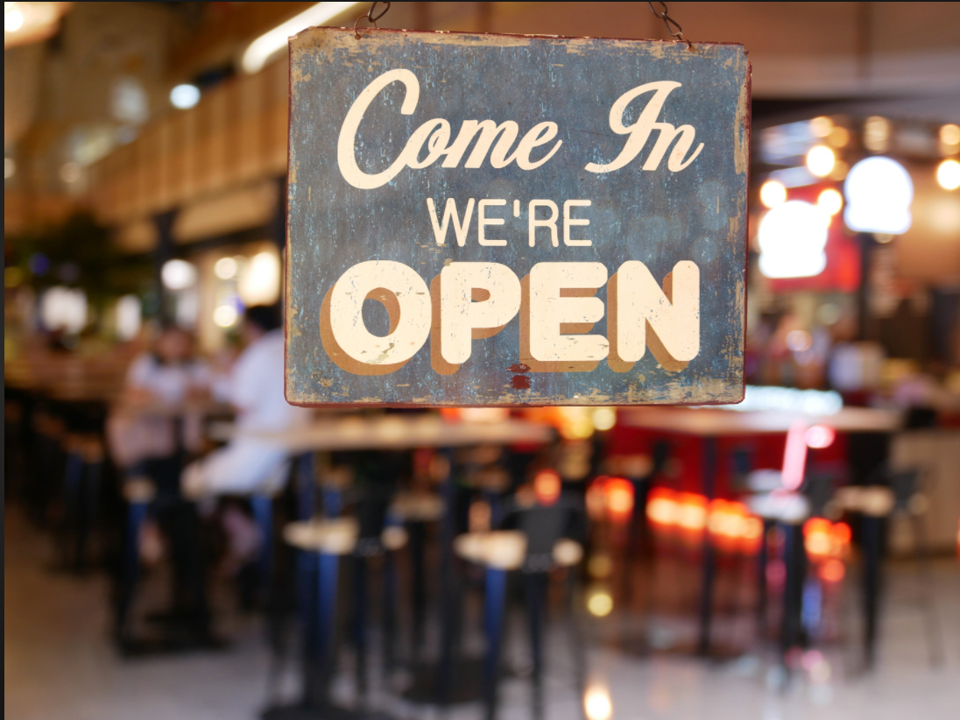
BACKGROUND
The goal is to inform potential business owners who are looking to expand in new areas. After pulling the data for these respective cities - we will have an ability to provide a recommendation. We will be using several data visualization techniques, in particular, we will be making use of Foursquare API to retrieve location data for the state of Toronto in Canada and use this data to perform data analysis.
INTEREST
This analysis will be useful for those who want to start a new business in the state of Toronto .It also aims on helping those who want to travel to Toronto and want to visit global Cuisine restaurants in Toronto. Clusters tell us what neighborhoods are fairly similar to each other so the person can skip travelling to many of the same neighborhoods.

Slide 4

PROBLEM
In growing regions - it is a challenge to know where it is appropriate to start a business, let alone what business to start. In this report we will be exploring the need for additional restaurants as in Toronto.
Prior launching any restaurant, it’s important to know if the business as a good opportunity. In order to do so, this report will try to gather data about other restaurant localization, competitors and best localization. also keeping in mind the nearby tourist spots they can visit which makes it easier for business person to choose the right neighborhood for their restaurant.

Slide 5

DATA ACQUISTION
The foursquare location platform will be used as the sole data source all the stated required information can be obtained through the API.

Slide 6
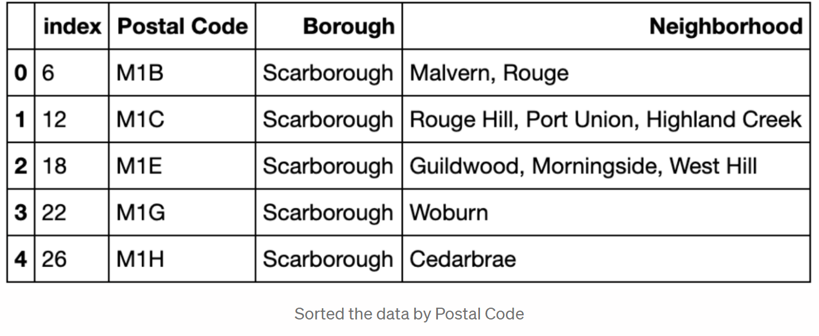
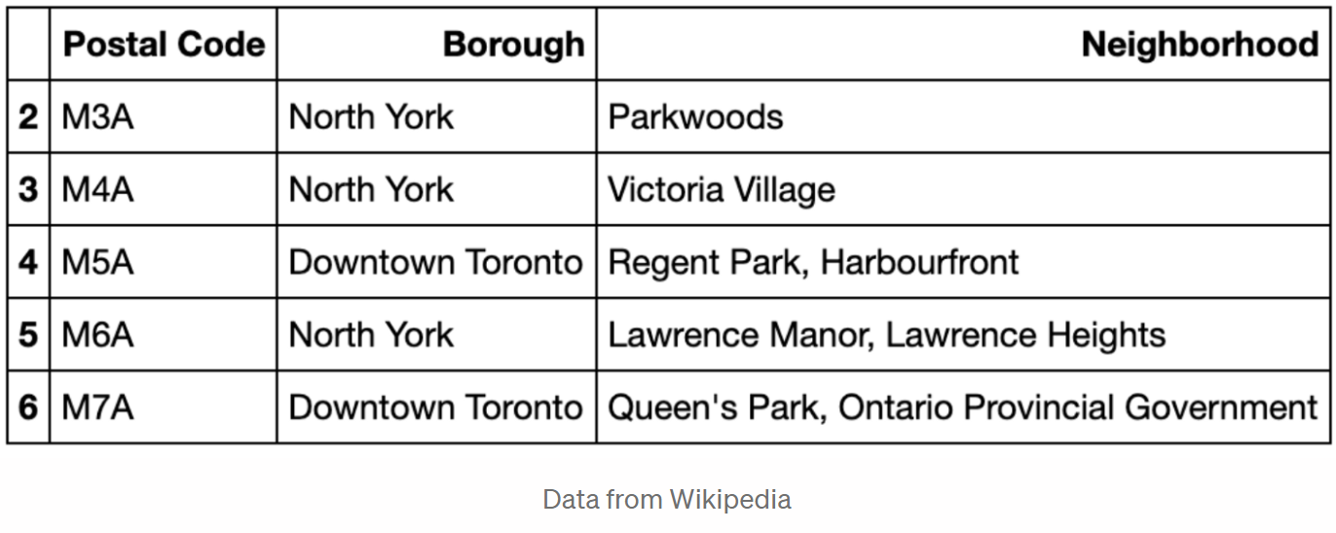
Cleaning Data:
We can combine rows that have same postal code and make them into a single row and neighborhoods that are associated with that postal code would be put into the same row separated by commas. We sort data buy the postal codes.
Feature Selection:
We focus on the neighborhood in Toronto. So drop all rows that have Borough outside of Toronto. And our dataframe is ready to use.

Slide 7
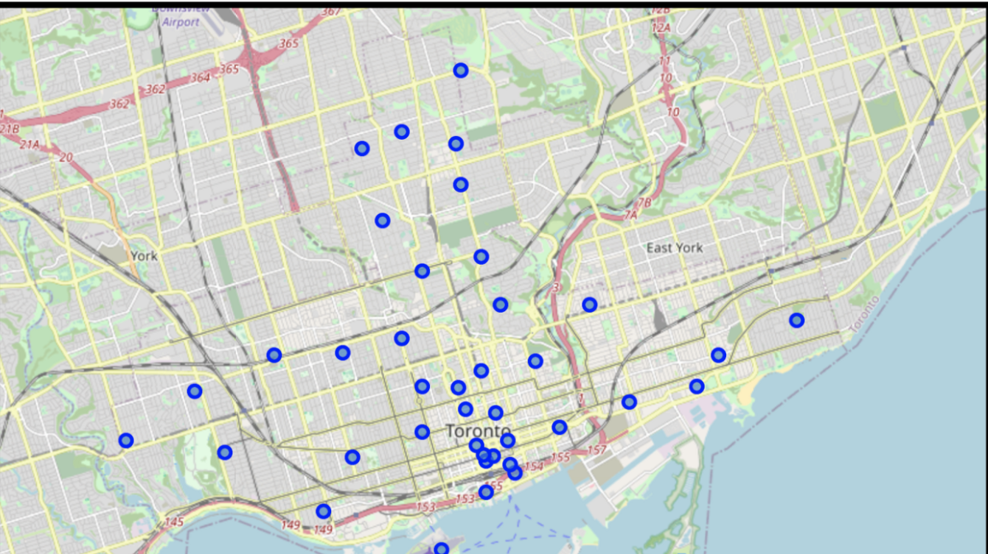
METHODLOGY
Presence of Vast data & Classification :
The dataset will allow us to group the neighborhoods together according to the similarity in the type of venues in each neighborhood.
We make use of the mean of the frequency of the occurrence of each category and combine the neighborhoods with similar venues.

Slide 8
CLUSTERING
We need to cluster data which is a form of unsupervised machine learning using k-means clustering algorithm .

Slide 9
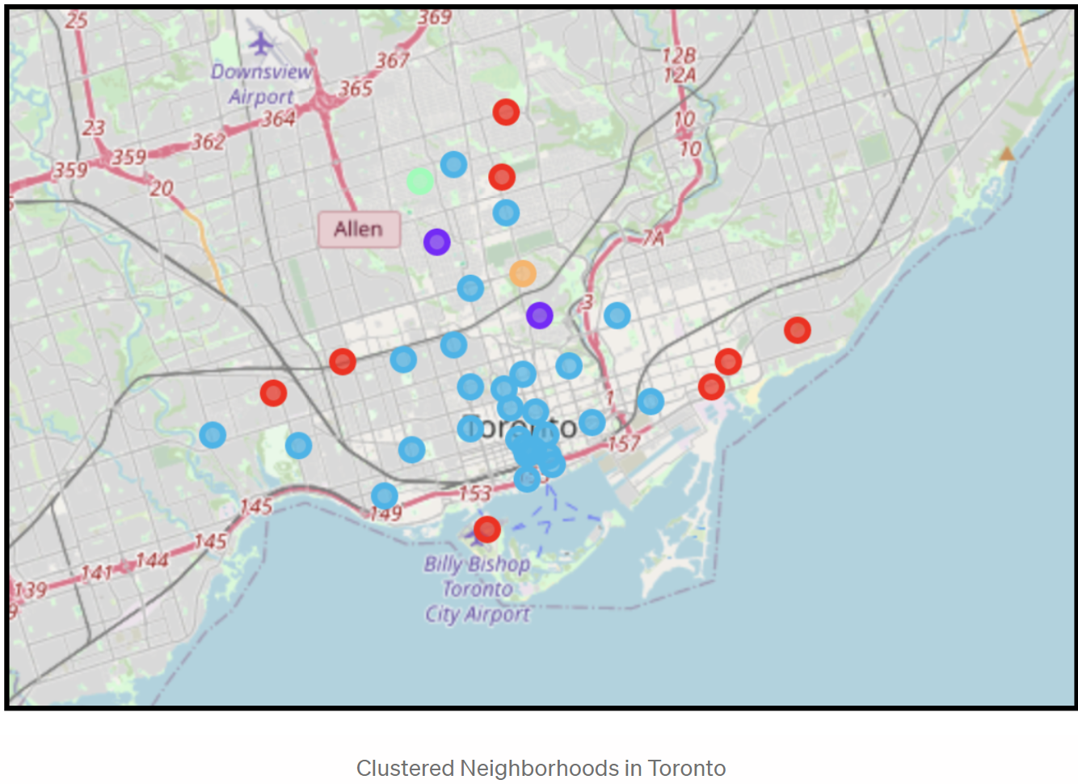

Slide 10
RESULT
The neighborhoods in the Red cluster are mainly on the outskirts of Toronto.
There are 2 neighborhoods that form their own cluster and one cluster (indicated in purple) consists of only 2 neighborhoods.
Since the neighborhoods were clustered based on the similarity in the categories of popular venues, it can be observed that most neighborhoods have the same category of venues.

Slide 11
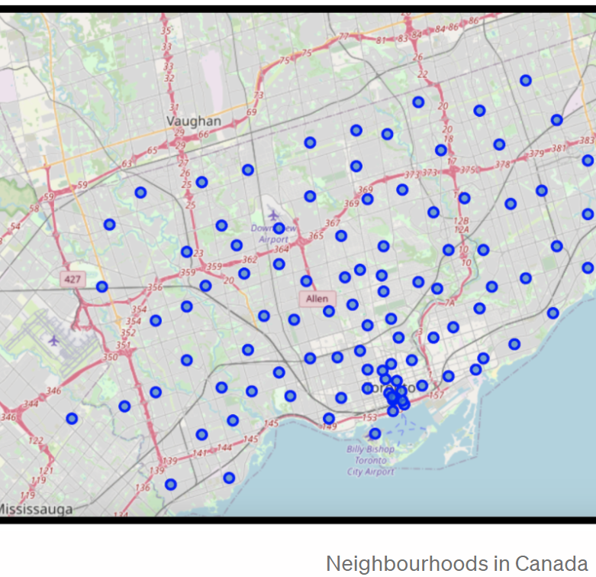
Conclusions
The clusters allow interested people to understand how similar neighborhoods are in Toronto.
Using the data about the 10 most popular venues in each neighborhood group allows people to choose the right neighborhood for starting a new business or opening a new branch for their already existing business.
The similarity in neighborhoods allows tourists to decide which places they should add on the to-visit list without making redundant choices. It also tells them what are the most popular places n each neighborhood that they must visit.

Slide 12

THANK YOU!

